Slide 1


MAULANA MUKHTAR AHMAD NADVI TECHNICAL CAMPUS
Affiliated to Savitribai Phule Pune University (SPPU)
Project Work Stage -2
The Presentation on
Weapon Detection In Real time Using YOLOv8 Model
Presented by:
TUSHAR DILIP AHIRE
KAMLESH WALIMIK MORE
NISHANT SURESH BACCHAV
KAMLESH ATMARAM KADAM
Under the Guidance of :
Guide: Prof.Siddiqui Mohsin
&
Co-guide: Dr. Salman Baig

Slide 2
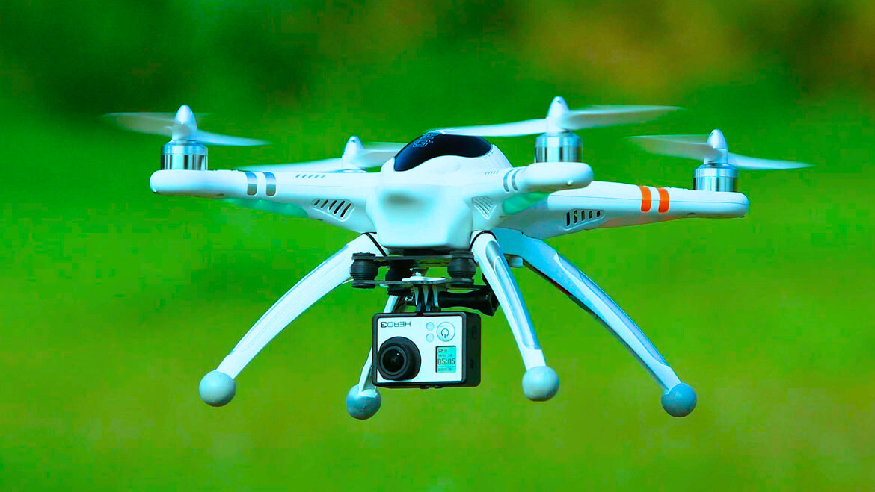





AGENDA
Introduction
Scope
Literature Survey
Contribution
Existing Gap
Methodology
Experimental Setup
Results & Discussion
Conclusion

Slide 3


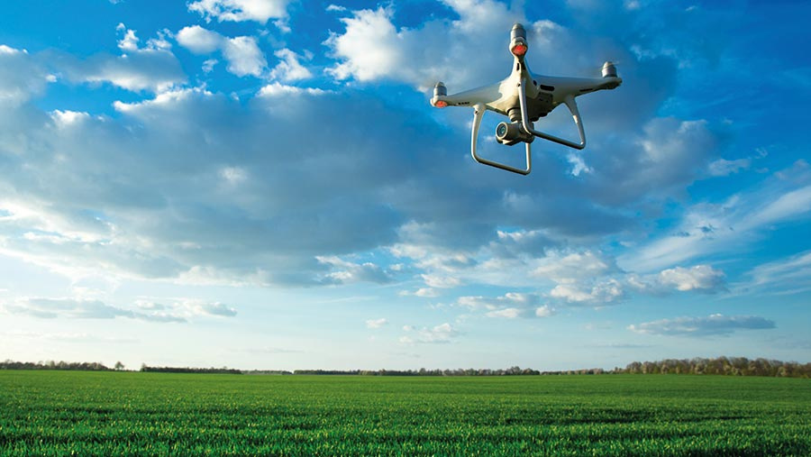

INTRODUCTION
The model is used to recognize the pattern of weapon
The detection of the weapon depend on training data and the design of the model.
Video surveillance has vast application areas particularly for indoor and outdoor places.
Surveillance is an integral part of security.
Today security camera becomes part of life for the safety & security purposes.
Today, manual monitoring of all the events on the CCTV camera is impossible.

Slide 4
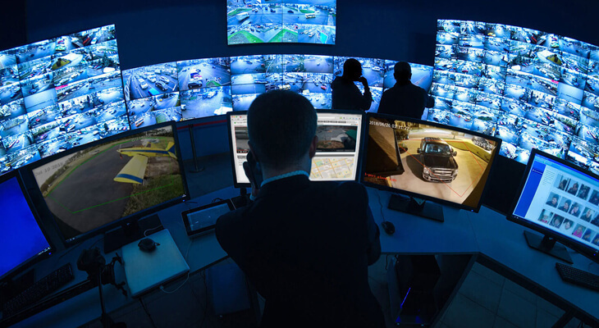


Scope
By developing an automated system that can detect and alert authorities about detected weapons , it may be possible to prevent or mitigate potential harm. Machine learning and Machine Learning techniques can be used to analyze large amounts of data and identify patterns that may indicate the weapons.
The Objective is to create a system to automate the task of analyzing video surveillance. We will analyze the video feed in real-time and identify any abnormal activities or weapons for theft or robbery and tracks objects within existing CCTV systems and automatically detects weapons and other violations of established security policies and procedures. An additional intention of this system is that it reduces people's cost with advanced technology.
5

Slide 5


LITERATURE SURVEY
Sr.No:
Author
Title
Publish Year
Technology Used
Accuracy
Narit Hnoohom,
Pitchaya Chotivatunyu,
Nagorn Matrichit
weapon detection using Faster R-CNN inception V2
2020
Algorithm: Faster R-CNN Inception Resnet-V2
Dataset: ARMAS & IMFDB weapon detection dataset
1
79.30 %
Muhammad Tahir Bhatti, Mohd Gufran Khan,
Masood Aslam, Muhammad Junaid Faiz
Algorithm :VGG16,Inception V3, Inception Resnet V2, SSDMobileNetV1, Faster R-CNN inception-Resnet V2(FRIRv2),YOLOv3
Dataset: Granda & IMFDB
Weapon Detection in Real-Time CCTV Videos Using Deep Learning
2021
2
91.21 %
Mirza Sohail Baig,
Dr. Pathan Ahmed Khan
weapon detection using AI for security applications
2022
Algorithm :CNN based SS D & Faster RCNN
Dataset:Pre Labelled images & set of images
3
84.6 %
Bhagyashree Kumbhar, Pranav Pisal,
Kunal Kene
suspicious activity detection using machine learning
2023
4
Algorithm :CNN and LSTM
Dataset:ARMAS
89.23 %

Slide 6





Contribution
Paper-1 contribution:-In contemporary security paradigms, real-time detection of weapons is pivotal, especially in vast, open spaces and critical infrastructure , in previous base paper [2021] they have used yoloV4 version and achieved the accuracy with 91.21% .
Our Contribution:-
We have developed the same model using YOLOv8 version.
We have improved the model & achieved the accuracy with 97.23%
We have enhanced the camera security and real time video surveillance has been improved .

Slide 7





Existing Gap
Limited
Training Data
Improved
Training Data
Less Accuracy
Improved
Accuracy
Old version
of YOLO model
Used Latest
version of
YOLO model

Slide 8

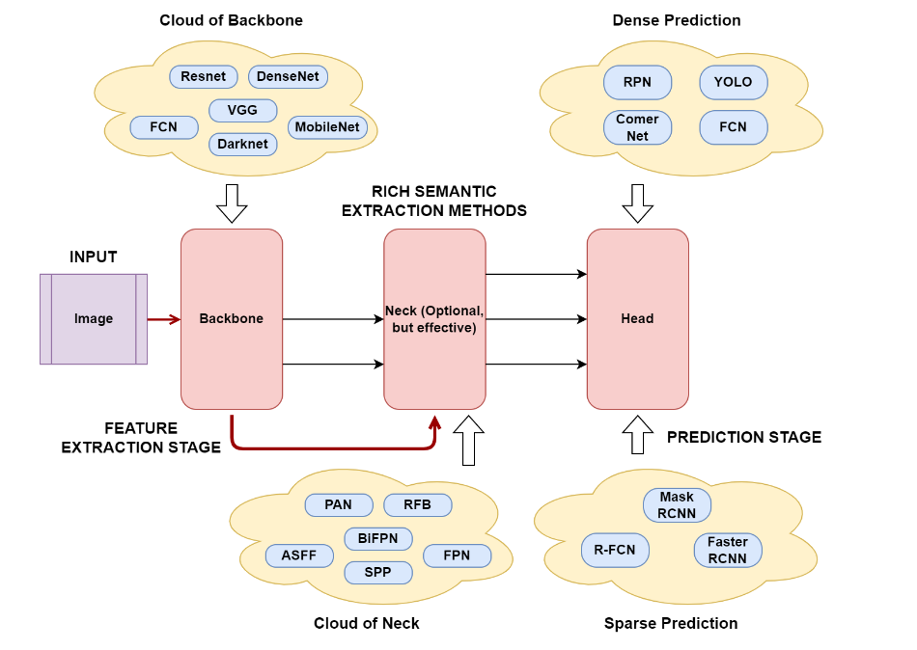
Methodology

Slide 9
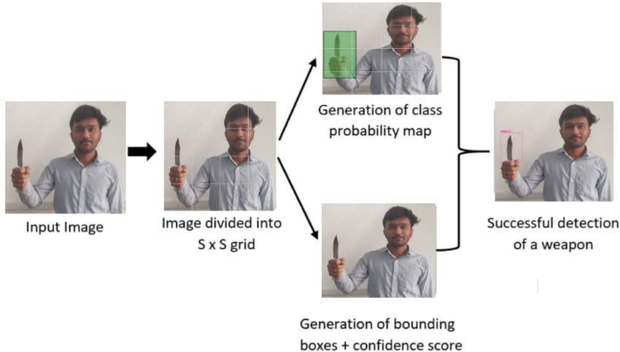

Slide 10
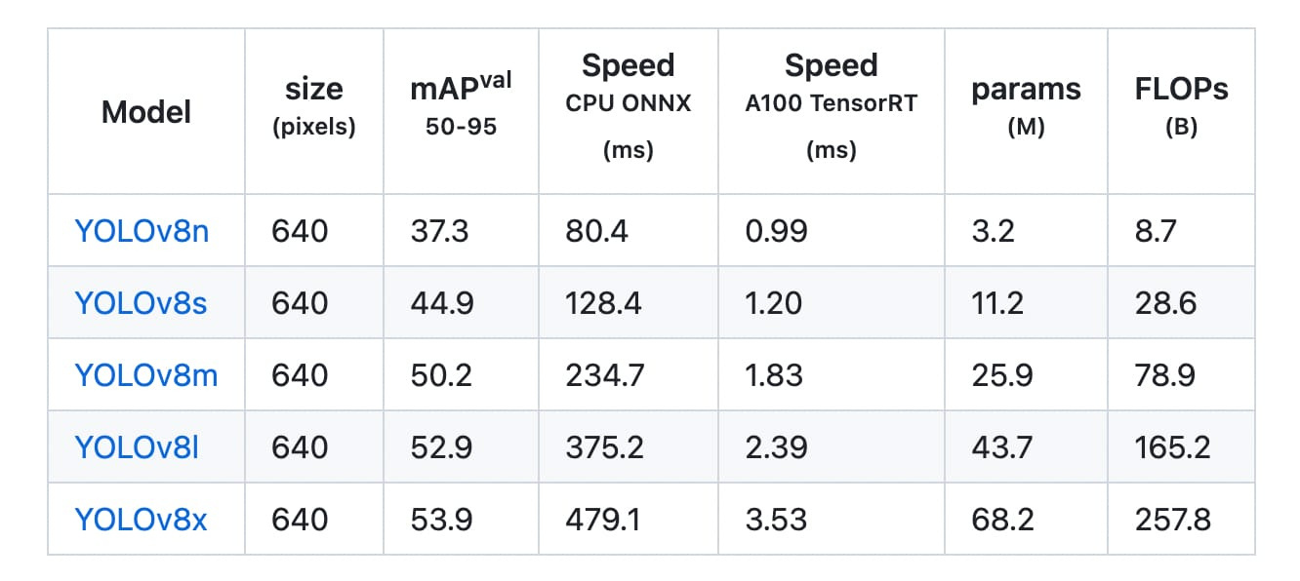
Collection of Dataset (YOLOv8)

Slide 11
Experimental Setup
HARDWARE
SOFTWARE
WINDOWS 11
PYCHARM
PYTHON(3.9.10)
GOOGLE COLAB
PACKAGES
Ultralytics
Numpy
C2V
Flask
YOLOv8
HIGHLY FEATURED SYSTEM
WITH
WEB CAMERA
8GB RAM
512 HDD / SSD
HIGH PERFORMANCE GUI

Slide 12


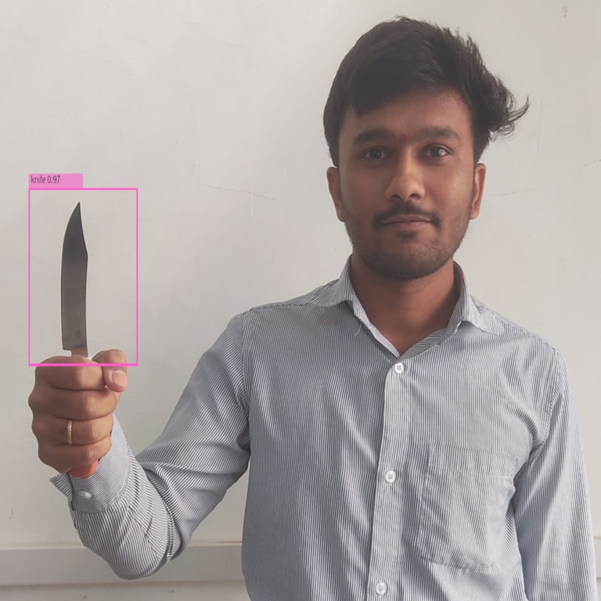


Result
YOLOv8
YOLOv8 Detection system

Slide 13

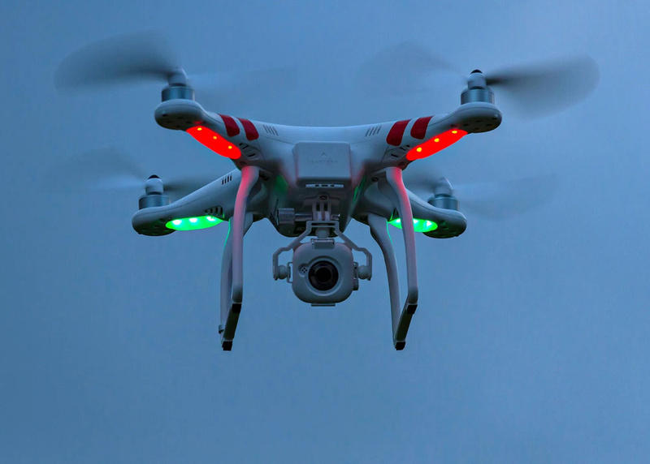

CONCLUSION
A project model is used to process real-time CCTV footage to detect a weapons would help in creating better security and less human interface in activities
In these presentation we have explored the motive and ideas about the project or model we are building for weapon detection

Slide 14
THANK YOU…

